Slide 1
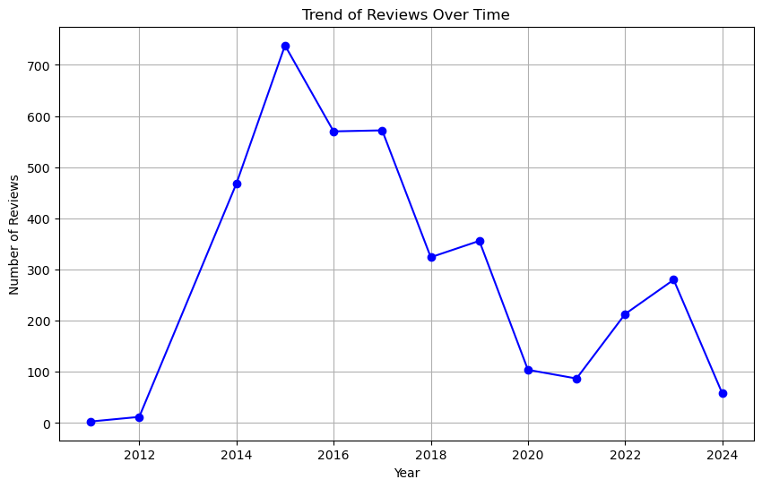
British Airways
Customer Review Analysis and Insights

Slide 2
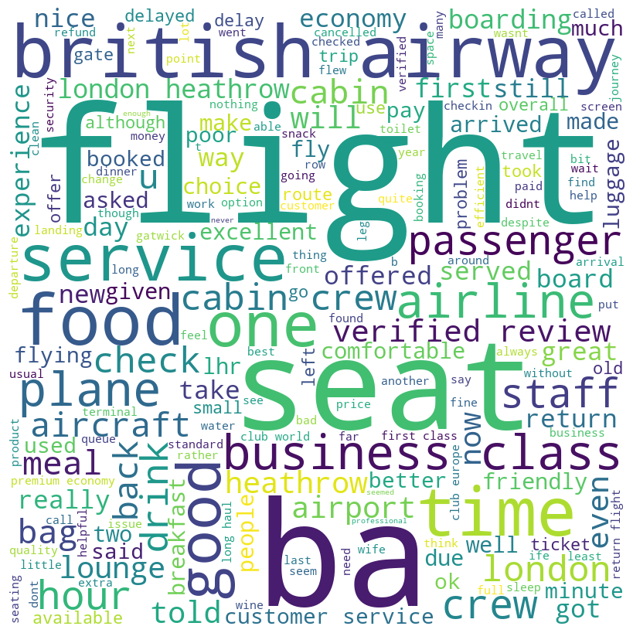
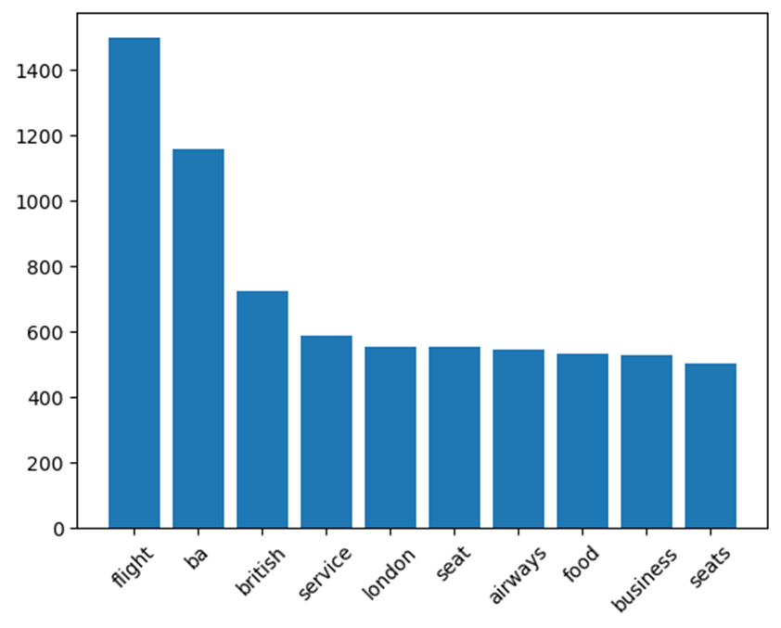
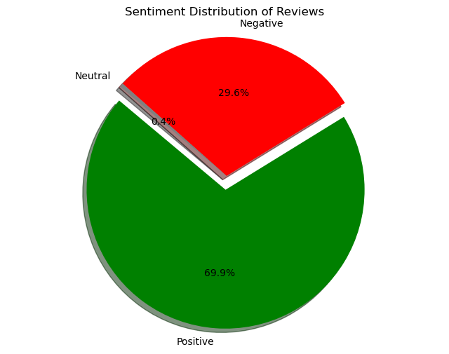
Insights for the Airline
Discussions around flights often include mentions of seats and food, indicating these are critical components of passenger satisfaction.
There is significant discussion around seating arrangements and class types, including business and economy.
Discussions indicate concerns with delays and service, specifically related to the duration and management of flights.
Recommendations
Enhance the quality of meals and maintain high standards for seating comfort. Regularly collect and review passenger feedback on these aspects to identify areas for improvement.
Focus on improving seat comfort across all classes, particularly ensuring that the differentiation in service and comfort between economy and business classes is justifiable and clear.
Improve operational efficiency to minimize delays. Increase transparency regarding any delays or issues, providing passengers with timely and accurate information to enhance trust.

